Slide 1


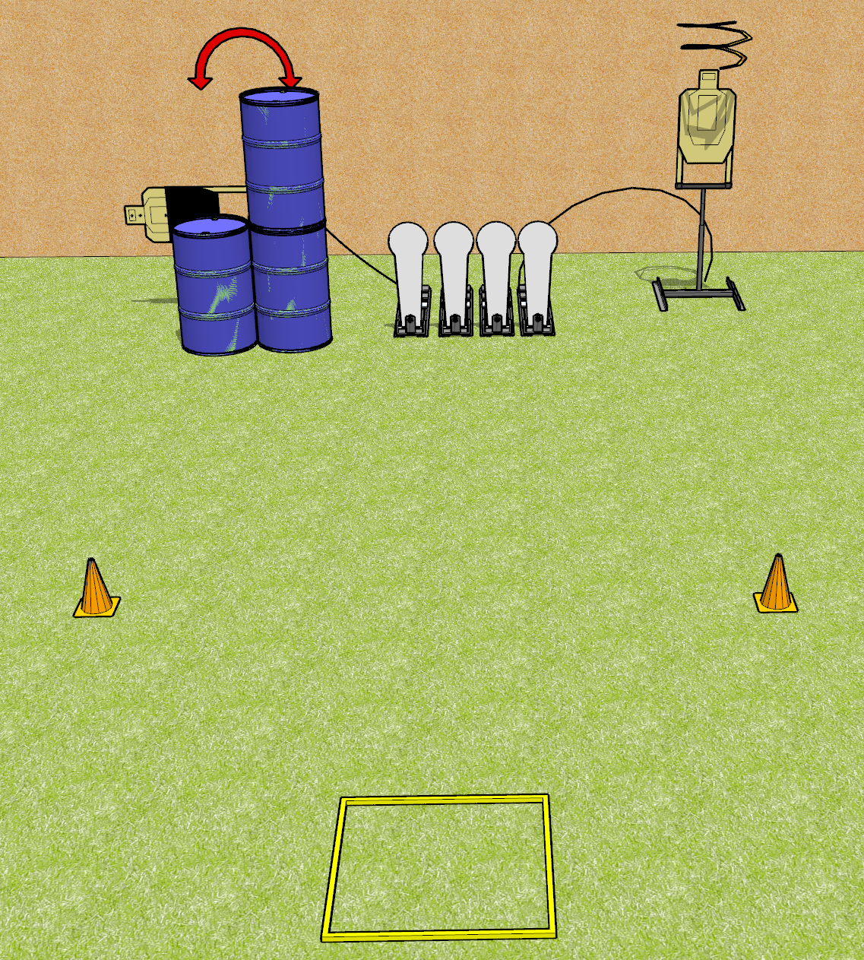
 | Dothan Gun Club – USPSA Match Fast AF Course Designer : Drew Coleman
8 rounds 2 USPSA 4 Colt poppers
Equipment List 1 shooting box Drop turner + activator 1 swinger + activator 1 50% hard cover

Slide 2
Fast AF
Written Stage Briefing
Fast AF is an 8 round, 40 point, Comstock speed shoot. There are 2 USPSA targets and 4 Colt poppers. The best 2 hits on paper will score, and steel must fall to score. The start signal is audible.
The swinger is activated by the leftmost popper and is not disappearing. The drop turner is activated by the rightmost popper and is a disappearing target. Please check the activators prior to walkthrough and set them the same way every time.
Handgun start position is in the shooting box, wrists above shoulders, facing up range. Handgun is loaded and holstered.
PCC start position is in the shooting box, muzzle pointed at either orange cone. Loaded carbine is held with both hands, safety on, shouldered.
On start signal, engage targets as they become available from within the shooting area.

Slide 3
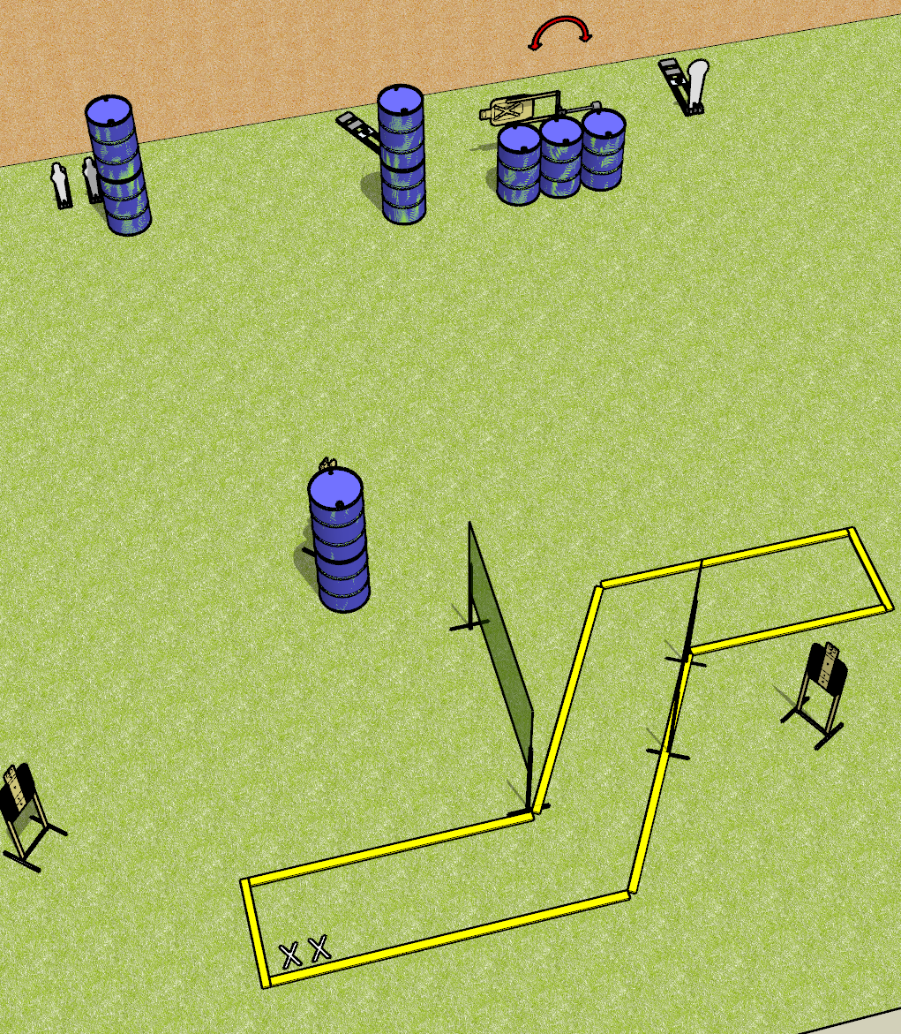
 | Dothan Gun Club – USPSA Match Canoe to Nowhere Course Designer : Drew Coleman
Round Count 12 rounds 4 paper 2 mini poppers and 2 Colt poppers
Equipment List 4 wall feet Swinger + activator 2 tuxedos

Slide 4
Canoe to Nowhere
Written Stage Briefing
Canoe to Nowhere is a 12 round, 60 point, Comstock short course. There are 4 USPSA targets, 2 Colt poppers, and 2 USPSA mini poppers. The best 2 hits on paper will score, and steel must fall to score. The start signal is audible.
The swinger is activated by the far right Colt popper. The swinger is not disappearing. Please check the activator prior to walkthrough and set it the same way every time.
Handgun start position is both feet on X’s, wrists below belt. Handgun is loaded and holstered.
PCC start position is both feet on X’s. Loaded carbine is held with both hands, stock on belt, safety on.
On start signal, engage targets as they become available from within the shooting area.

Slide 5
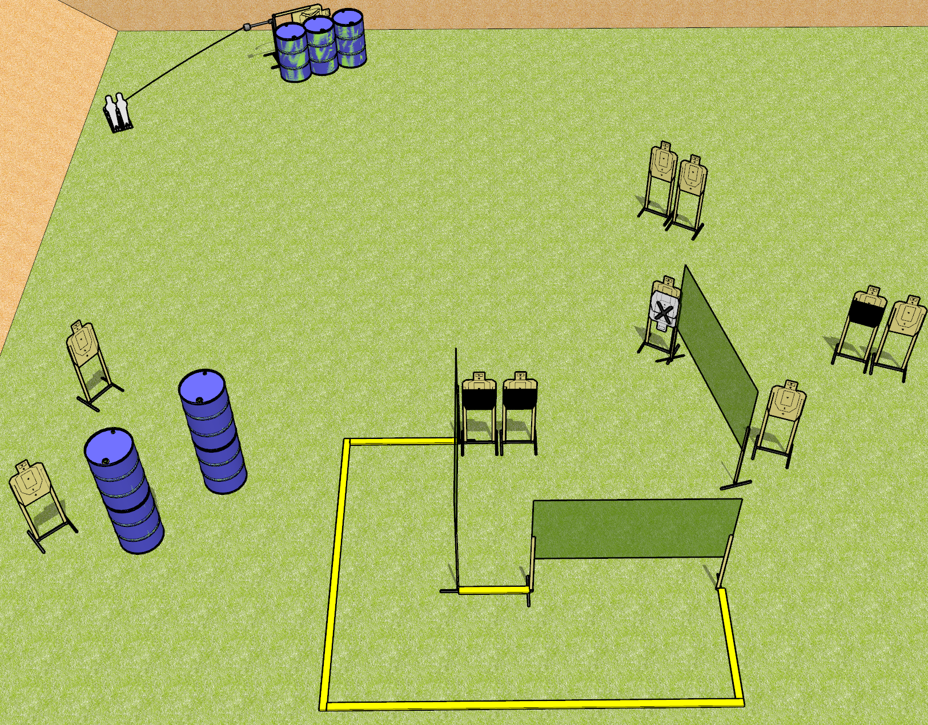
 | Dothan Gun Club – USPSA Match Chicken Little Course Designer : Drew Coleman
24 rounds 11 USPSA 2 mini poppers
Equipment List 6 wall feet 1 swinger + activator Make the hard cover show 1/3 of the lower A-zone

Slide 6
Chicken Little
Written Stage Briefing
Chicken Little is a 24 round, 120 point, Comstock course of fire. There are 11 USPSA targets and 2 USPSA mini poppers. The best 2 hits on paper will score, and steel must fall to score. The start signal is audible.
The swinger is activated by either popper. Please check the activator prior to walkthrough and set it the same way every time.
Handgun start position is outside the shooting area, heels against the most downrange fault line, wrists above shoulders. Handgun is loaded and holstered.
PCC start position is outside the shooting area, heels against the most downrange fault line. Loaded carbine is held with both hands, stock on belt, safety on.
On start signal, engage targets as they become available from within the shooting area.

Slide 7
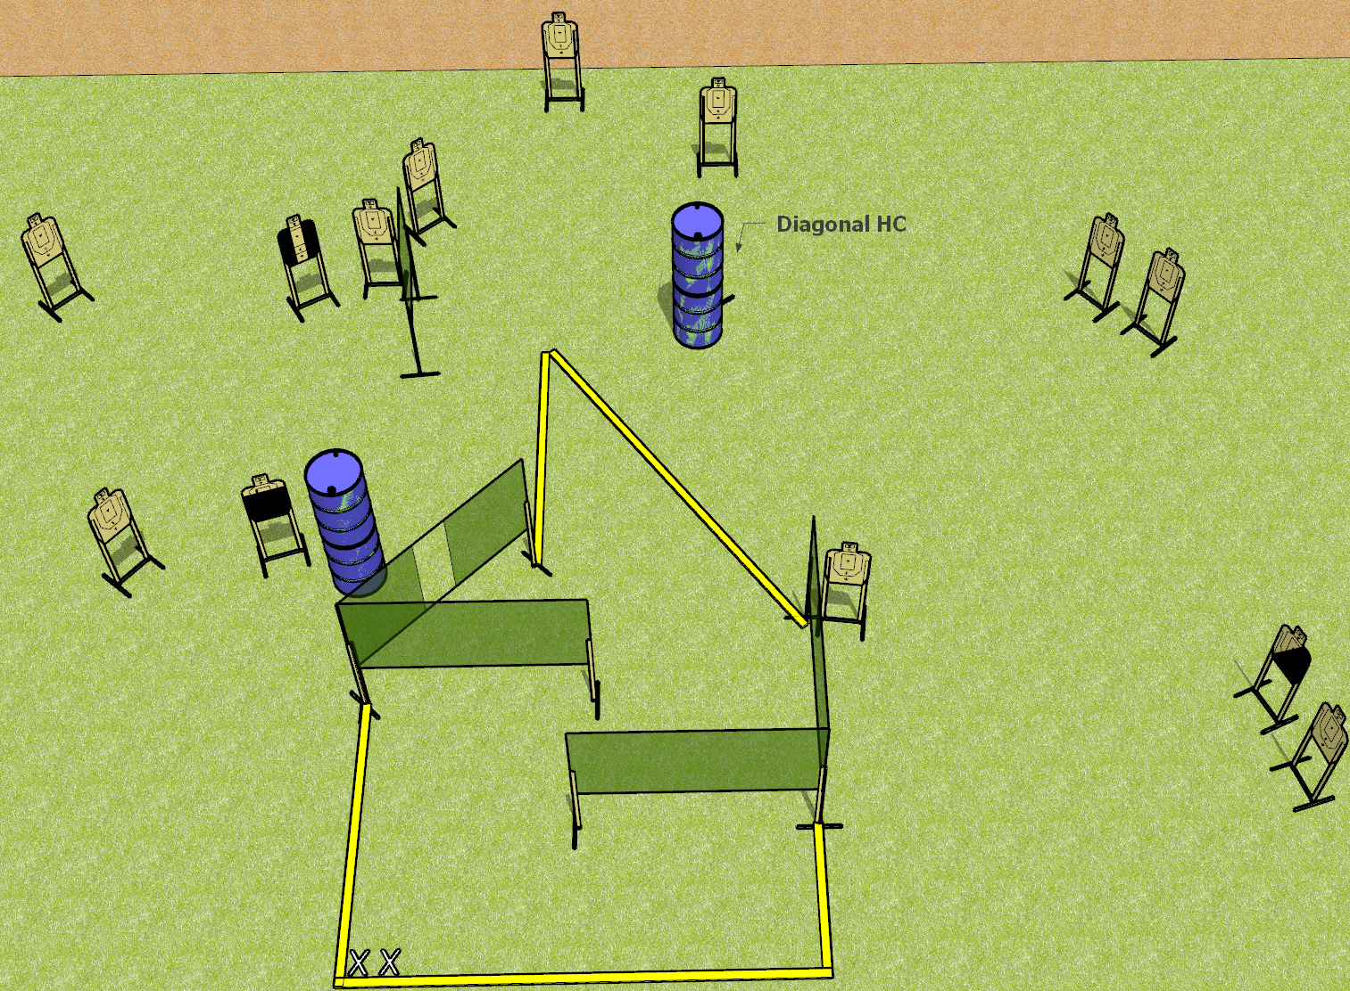
 | Dothan Gun Club – USPSA Match Step it Up Course Designer : Drew Coleman
28 rounds 14 paper
Equipment List 7 wall feet 1 medium fault line Hard cover: 1 left diagonal, 1 right diagonal, 1 tuxedo, 1 with tape 5 inches below the shoulder perf

Slide 8
Step it Up
Written Stage Briefing
Step it Up is a 28 round, 140 point, Comstock field course. There are 14 USPSA targets. The best 2 hits on paper will score. The start signal is audible.
Handgun start position is both feet on X’s, wrists below belt. Handgun has loaded magazine inserted, empty chamber, holstered.
PCC start position is both feet on X’s. Carbine is held with both hands, loaded magazine inserted with an empty chamber, safety on.
On start signal, engage targets as they become available from within the shooting area.

Slide 9
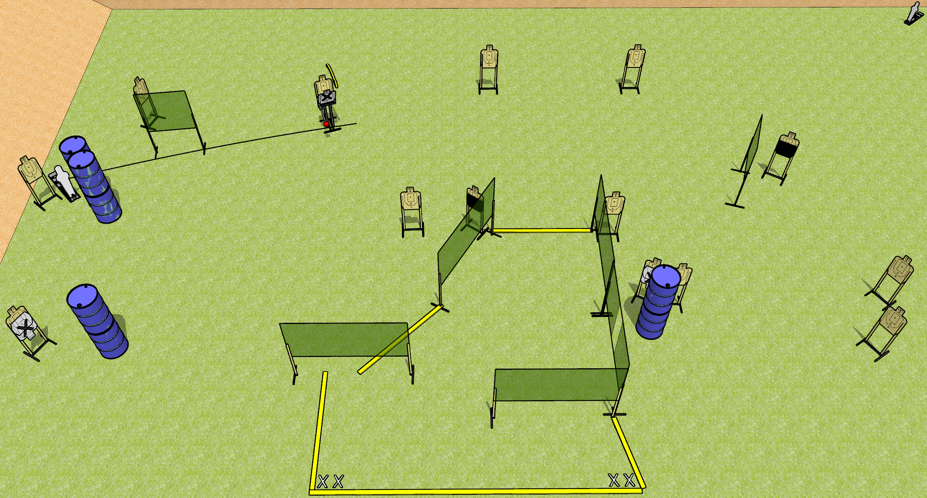
 | Dothan Gun Club – USPSA Match Mixtape Course Designer : Drew Coleman
30 rounds 14 USPSA 1 mini popper, 1 pepper popper
Equipment List 12 wall feet Max trap + activator 2 50% hard cover, consider mixing a tuxedo or 2 in SETUP NOTE: check stage flow and consider omitting the far-right small wall next to the hard cover

Slide 10
Mixtape
Written Stage Briefing
Mixtape is a 30 round, 150 point, Comstock field course. There are 14 USPSA targets, 1 pepper popper, and 1 USPSA mini popper. The best 2 hits on paper will score, and steel must fall to score. The start signal is audible.
The max trap is activated by the pepper popper, and is not a disappearing target. Please check the activator prior to walkthrough and set it the same way every time.
Handgun start position is both feet on either set of X’s, wrists below belt. Handgun is loaded and holstered.
PCC start position is both feet on either set of X’s. Loaded carbine is held with both hands, stock on belt, safety on.
On start signal, engage targets as they become available from within the shooting area.

Slide 11
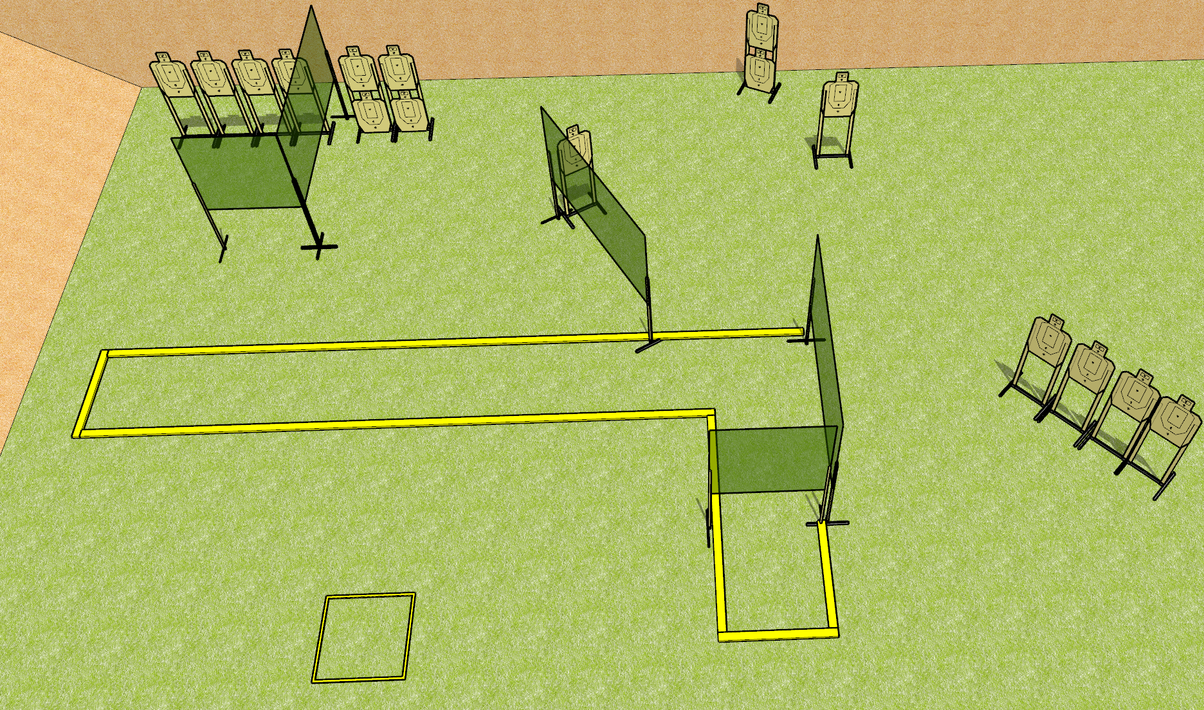
 | Dothan Gun Club – USPSA Match So you think you can hit factor Course Designer : Drew Coleman
Round Count 32 rounds 16 paper
Equipment List 8 wall feet 2 medium fault lines

Slide 12
So you think you can hit factor
Written Stage Briefing
So you think you can hit factor is a 32 round, 160 point, Comstock field course. There are 16 USPSA targets. The best 2 hits on paper will score. The start signal is audible.
The start box is not part of the shooting area.
Handgun start position is in the starting box, wrists below belt. Handgun is loaded and holstered.
PCC start position is in the starting box. Loaded carbine is held with both hands, safety on.
On start signal, engage targets as they become available from within the shooting area.

